Slide 1


Green Pace
Security Policy Presentation
Developer: Samantha Durr
Notes:
Welcome, I am your presenter, Samantha Durr, and this is the Security Policy Presentation for Green Pace. This presentation is to help you understand the security policy that exists at Green Pace and allows for ensuring the quality and commitment to the standards presented. Security is important in that it helps to reduce the vulnerabilities and attack surface that can exist in an application and system. Let’s get into it.

Slide 2

OVERVIEW: DEFENSE IN DEPTH
-The security Policy is meant for creating a standard.
-Defines the coding standards expected of the developers working at Green Pace.
-Indicates policies for encryption and Triple-A.
-Examples of Unit Tests on a specific coding standard.
-Outline the tools, risks, benefits, and recommendations.
Notes:
The security policy implemented here is for creating a standard. This exists to provide a specific set of guidelines and procedures to help the system remain secure. As can be seen in the diagram to the side, there are multiple layers of security that we want to implement. This means checking the different layers of security, that encryption is implemented, and that Triple-A standards are followed. All of these are detailed in the documentation if you wish for a more in-depth explanation.

Slide 3
THREATS MATRIX
This threat matrix uses the coding standards to determine threat level.
There is a lot of overlap in the threats.
Likely STD-003-CCP: String Correctness STD-004-CCP: SQL Injection STD-008-CPP: Error Handling STD-009-CPP: Signals | Priority STD-001-CCP: Data Type STD-002-CCP: Data Value STD-003-CCP: String Correctness STD-004-CCP: SQL Injection STD-008-CPP: Error Handling STD-009-CPP: Signals STD-010-CPP: Hard Coding
Low priority STD-002-CCP: Data Value STD-005-CPP: Memory Protection STD-006-CPP: Assertions STD-007-CPP: Exceptions | Unlikely STD-001-CCP: Data Type STD-006-CPP: Assertions STD-010-CPP: Hard Coding
Notes:
A threat matrix lets us determine what should be a priority. As can be seen in this threat matrix, we are using our security standards to determine what is likely, unlikely, and the priority level. When it comes to determining likeliness, we are able to do this because of the coding standards that were implemented. When looking at these standards, we are able to see what has a high level of severity, but also the likeliness. This creates overlap in that something can be unlikely, but also a priority because it has a high severity. This matrix helps in determining what vulnerabilities need to be handled first, especially if they’re both likely and a high risk.

Slide 4
10 PRINCIPLES
Validate Input Data
Heed Compiler Warnings
Architect and Design for Security Policies
Keep it Simple
Default Deny
Adhere to the Principle of Least Privilege
Sanitize Data Sent to Other Systems
Practice Defense in Depth
Use Effective Quality Assurance Techniques
Adopt A Secure Coding Standard
Notes:
When writing secure code, there are 10 principles. These principles are validate input data, heed compiler warnings, architect and design for security policies, keep it simple, default deny, adhere to the principle of least privilege, sanitize data sent to other systems, practice defense in depth, use effective quality assurance techniques, and adopt a secure coding standard. The last policy is the coding standard that has been described in the security policy document and will be explained after this.
In regards to the other principles, we need to validate the data that has been put into the application. This includes all data, such as username and password, personal information, and anything input by users. This data needs to be validated to make sure that it is okay and accurate.
The next principle of heed compiler warnings is a tool that ensures that your code does not contain insecure code, deprecated features, and also catches errors that may not be that obvious. These errors can sometimes not show up until you actually build the code. This relates into designing and architecting for security policies. Keep these policies in mind as we want to have our DevOps be DevSecOps and include security from the very beginning. The final level is important for this. It matches in with keeping it simple. The simpler you keep your code, the easier it will be to maintain and find security issues before they actually become one. This also allows for other developers to come in and more easily understand your code.
Since there is defense in depth added to the security policy, we want to ensure that there are multiple layers. This is where Default deny comes in. We want to have users be denied access until it is determined what their level of privilege needs to be. This means that if they cannot access something, it needs to be denied. Users should only have the amount of access that they need and no more. This is where the default deny refines itself into the least privilege principle. This principle is more strongly seen by the IT department in that they control internal users access to data, but please be aware of this in the development side as well.
As for sanitizing data, this is where we want to ensure that any data travelling in or out of the network is looked over before it reaches the destination. Any suspicious components of the data are removed and only the clean form gets to where it goes. This actually can relate into practicing quality assurance techniques. This standard allows for testing the code for a level of quality that both meets the standards outside of security, but also with that layer as well.

Slide 5
CODING STANDARDS
Obey the One-Definition Rule
Only 1 definition per function.
Do not Read Uninitialized Memory
Make sure all variables are initialized.
Do not Attempt to Create a std::string from a Null Pointer
Uses a basic_string type, always have a string.
Prevent SQL Injection
Avoids malicious data from being put into databases.
Free Dynamically Allocated Memory when No Longer Needed
Make sure that memory is not held up when no longer needed.
Use a Static Assertion to Test the Value of a Constant Expression
Helps to find vulnerabilities.
Do not Abruptly Terminate the Program
Avoid using functions that terminate programs without the exit handlers being called.
Detect and Handle Standard Library Errors
Helps to keep code up-to-date.
Do not Access Shared Objects in Signal Handlers
Keeps data consistent.
Never Hard Code Sensitive Information
Keep your sensitive information encrypted.
Notes:
Coding standards are important for quality of code, but also for security. There are 10 standards that have been implemented at this company. The first standard is Obey the One-Definition rule. You only want one definition for your functions. This is important in that you will create less confusion, but also keep your code simple. This is an unlikely vulnerability, but it is also a high in the severity index.
The next standard is Do not Read Uninitialized Memory. When you leave something like a variable uninitialized, the pointer will point to whatever it wants. This can cause problems and potential security holes as you never know when someone inserts something malicious in the system. This has a likeliness level of probable, but is also high on the threat index.
The third standard is Do not attempt to Create a std::string from a Null Pointer. Empty strings are similar to uninitialized variables. With a null pointer, you have a pointer that will never point to a valid memory location. This can cause complications in that you can have invalid locations. These locations can contain bad data that can cause issues. This is more likely to happen and has a high-risk of level.
Prevent SQL Injections can feel obvious, but these are both a high risk and likely to happen. SQL injections are vulnerabilities where untrusted data is injected from a SQL query. Preventing this allows for avoiding altered data. This is where sanitizing data is important.
The standard of Free Dynamically Allocated Memory when No Longer Needed is important in that it helps the system. This memory sometimes needs to be used by other areas and freeing up the memory ensures that data is cleared when no longer needed, but it also keeps the system from holding onto that memory and causing issues. This does have a likeliness of probable and only has a medium level of risk.
The Use of a Static Assertion to Test the Value of a Constant Expression is another important tool. These tools help you find vulnerabilities in your code and any potential leaks. This being a diagnostic tool, it runs a low risk and is unlikely to have issues happen.
Please do not abruptly terminate a program. This standard exists in that using functions like abort, quick_exit, and exit can cause the system to exit a program and not call the exit handlers. This can leave data in the system and allow for holes that people can use. This is a low risk, but does have a likeliness of being probable.
The third to last standard is Detect and Handle Standard Library Errors. As with heeding compiler warnings, this relates to you keeping your code to the latest level that helps it remain secure. This does have a high risk because it can be exploited and is likely to be an issue, especially in legacy systems.
The next standard is do not access shared objects in signal handlers. This is important in that you want to keep your data consistent. Having the consistent data allows for searching, reducing the risk of malicious data, and handling errors. Another part of this is that when you use a variable as a pointer, it is not a volatile variable. This is both likely to be an issue and also a high risk.
The last standard is to never hard code sensitive information. When testing your code, it can be tempting to do this, but you should not because this is a way to open vulnerabilities in the system. If someone has that information, they can always get into the system. This is not something you want. This does have a likelihood level of probable, but it is a high risk.

Slide 6
ENCRYPTION POLICIES
Encryption in rest: ensure that all data is encrypted on a disk, device, and other systems when it is not in use or traveling.
Encryption in Flight: ensure that the data being transmitted is encrypted when it is travelling both within the network and outside of it.
Encyption in Use: ensure that the data is still encrypted when being used, changed, or modified.
Notes:
In regards to the data on the network, we need to keep it encrypted. All of the data on the system needs to be encrypted whether it’s at rest, travelling, or being used.
When at rest, we need to keep all devices, hard drives, and so on at a level of encryption that protects the data on the system.
This is also true for when it is traveling. It doesn’t matter whether or not it is from inside or outside of the network. It needs to be encrypted to protect it from man-in-the-middle attacks. This keeps it from being viewable on the outside. This also relates into the security policy of sanitizing the data.
As for in use, data can be vulnerable when being accessed and we need to ensure that the data is still encrypted when in use. This keeps the data from being viewed by those that do not have the encryption access to the data. You can use this on documents and other programs to ensure that what you’re working on remains safe.

Slide 7
TRIPLE-A POLICIES
Authentication: all users need to be authenticated by a minimum of a username and password. Multi-factor authentication is recommended.
Authorization: All authenticated users have their rights and privileges authorized to keep people from doing things they should not.
Accounting: monitor all activities and recordings for compliance and security purposes.
Notes:
All users need to be authenticated. Nobody should have access to the network and data that do not have authentication from within the network. Keep in mind, this is often handled by the IT department, but everyone needs to adhere to this. This means that we can match username and password to the specific user. Multi-factor authentication is another important way to help authenticate people and keep everything more secure.
This relates to the authorization in that people who are authenticated for the system are only able to access data and features that are connected to their account. This relates to default deny and least privilege principles.
As for accounting, we will be monitoring activity on the network to ensure that there are no unauthorized users or people accessing what they should not. This can relate to regular security audits to make sure that the system is not vulnerable, but can catch when there are holes.

Slide 8
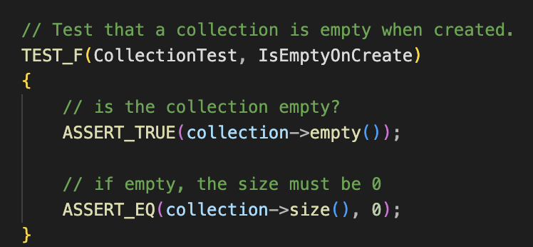
Unit Testing
Is Empty on Create
New collection created, but should not have any items placed within
Notes:
Unit testing is when you break down a program into smaller pieces. You test each component to ensure that they run properly. When testing for security, you often assert that the desired situation has occurred.
A simple test that can be run is an Is Empty on Create unit test. The idea behind this test is that a collection is created and does not have anything within it when done. This is a good idea for a unit test when working with databases and series of data. Without ensuring that a collection is empty, it is possible for data to be instantiated within the collection and result in possible bad or malicious data getting in the system.

Slide 9
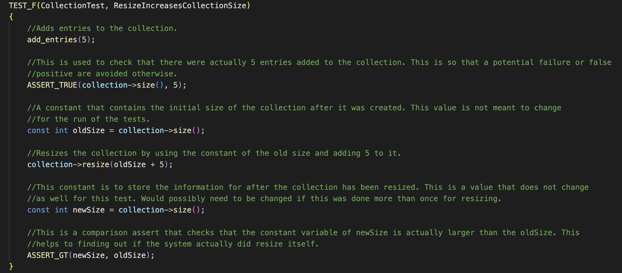
Unit Testing
Resize Increases Collection Size
The size of a collection can increase when data is added.
Notes:
Another useful test for ensuring that your data is not being manipulated in a wrong way is the ability to resize a vector. The reason that you want this is because your data will always change and you need to ensure that the system can handle that change. If it doesn’t, then you know something is wrong with the code. It’s also a way for validating information because the resize can always be changed to only store validated data. It is a way to stop people from inserting bad data into the system.

Slide 10
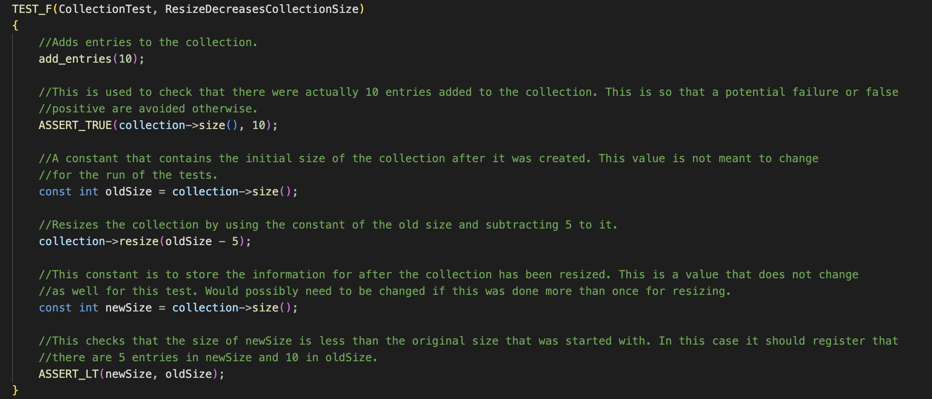
Unit Testing
Resize Decreases Collection Size
The size of a collection can decrease when data is removed.
Notes:
On the other side of that, you get the Resize decreasing the collection. This is another way to ensure that your data changes with your system. When you’re looking to protect your data, you need to be aware of any changes to your collection, or vector, that can potentially cause harm. If you’re able to decrease the data, you can remove inactive data or see when pertinent data may be missing. This allows for ensuring that you’re aware if something is potentially happening. Once again, you can set it up to ensure that only validated actions make these changes.

Slide 11
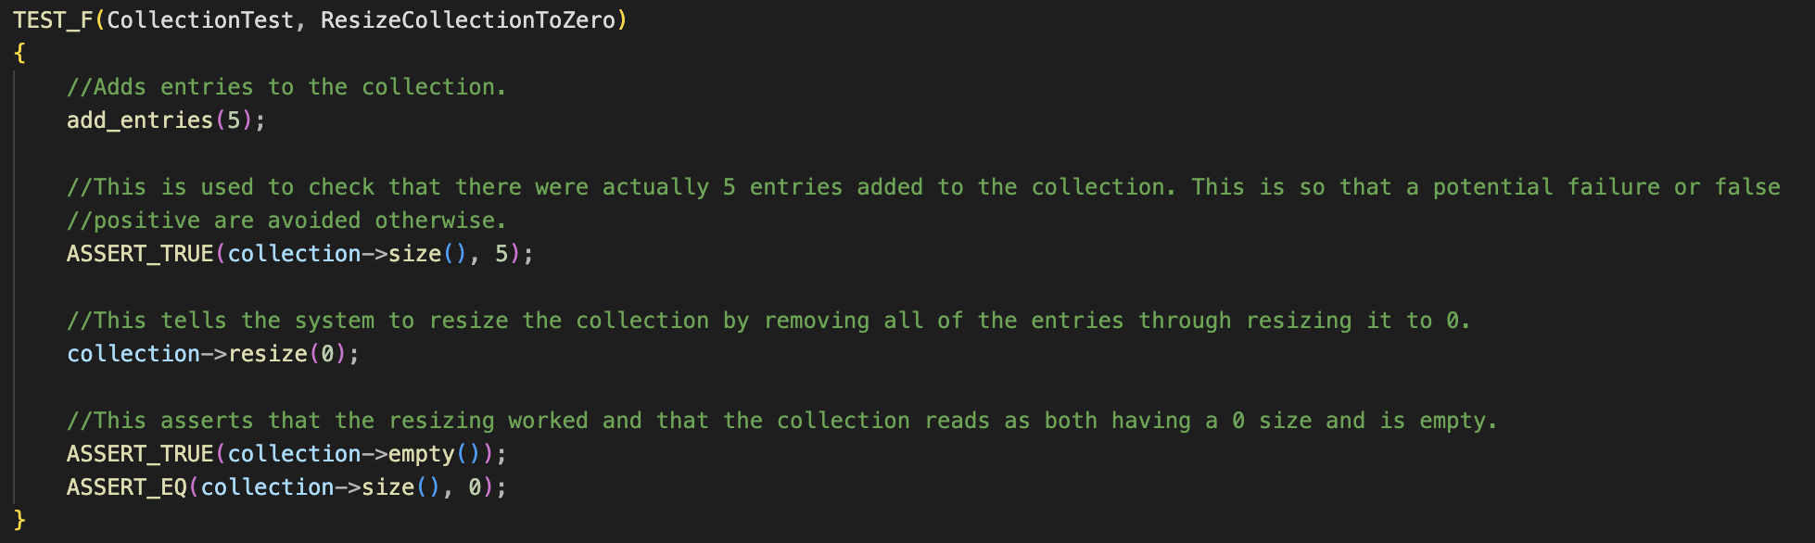
Unit Testing
Resize Collection to Zero
The vector or collection is capable of being changed to 0.
Notes:
The other important factor when you’re looking at the change in your data is when your vector is empty. This is an important unit test as you can ensure that the system warns you when the action is performed without the proper authorization. Since that means all of your data stored in there is no longer accessible, you do not want that vector empty at random. You only want authorized actions to determine if this is the case. Of course, for security, you would want the data removal to always inform the correct people. This is a way to ensure that you can see it happening and set that validation.

Slide 12
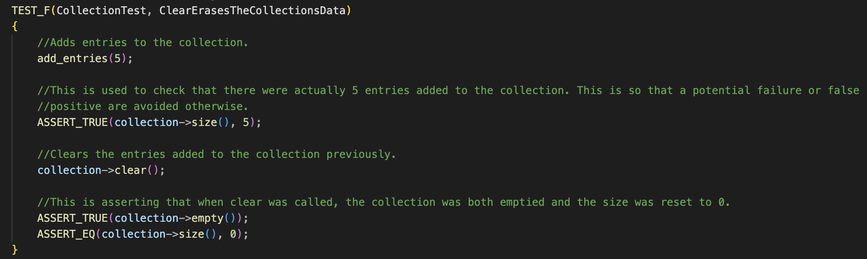
Unit Testing
Clear Erases the Collection’s Data
Resets the size to 0, but data is still in memory. It cannot be accessed through the vector.
Notes:
To keep in the theme of watching your data change and remaining aware of unauthorized changes, we have another emptying feature, which is the Clear feature. As with resizing your data to 0, this is another way to change the size of your vector to 0. The data that was available is still in the system, though it’s in memory. This means that it can no longer be accessed by the vector. Knowing when this happens, and is capable of happening, allows you to keep track of whether or not the actions are authorized or not. It is, once again, a good idea to add in specific authorizations to keep people from doing this.

Slide 13
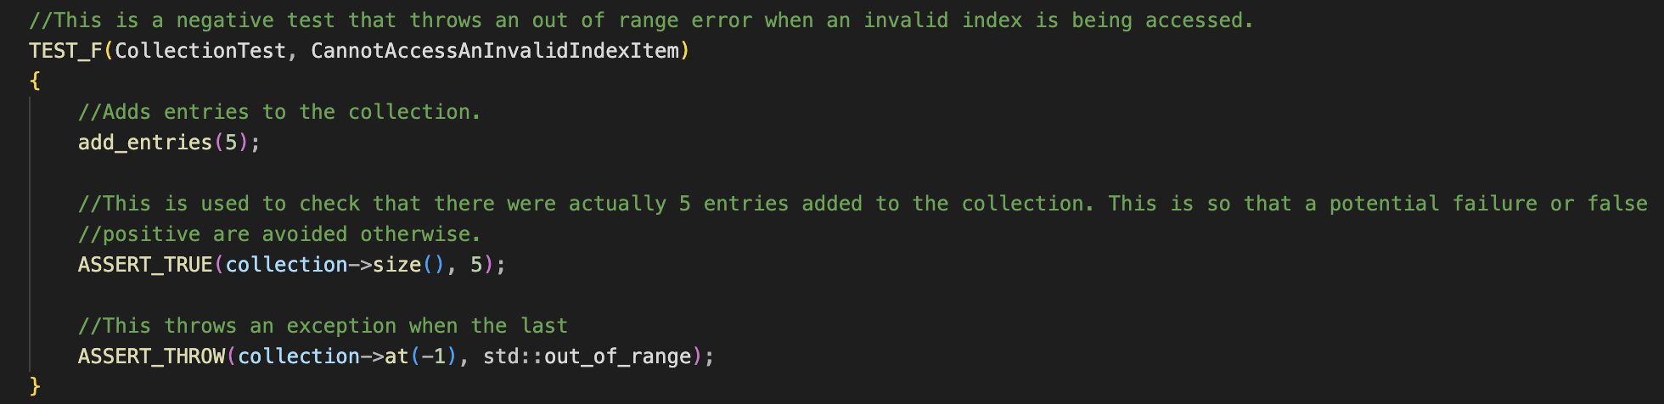
Unit Testing
Cannot Access An Invalid Index Item
Keeps the system from being able to access data that’s invalid.
Notes:
The last example that is going to be important is accessing invalid index items. The reason that this is an important test to run is that malicious data can often try to insert itself wherever it wants and not be indexed. When this data is able to be accessed, it can cause issues and holes in your security. The ability to ensure that the data cannot be accessed when the index is invalid keeps the system from running that malicious data before it can cause a problem. This is sort of a stop gap if earlier changes to the vector do not employ properly.

Slide 14

AUTOMATION SUMMARY
Notes:
To enforce and ensure compliance in regards to the security policy, automation will be employed. Adding this into the DevOps will allow for security to be an integral part of the process from the assessment and planning all the way through to deployment of the product.
Once the product has been put into production, penetration tests can be automated, along with monitoring, and maintaining the system.

Slide 15
TOOLS
The DevSecOps Pipeline is where security is included in the development and production process.
Parasoft C/C++test: used by many of the coding standards that we have, this tool is used during the design and verify/testing stages of the pre-production space. It is also used to help maintain health when the system has reached production stage.
Astrée: this is a static analysis tool that is good for ensuring that data is process correctly through the flow. This tool is useful during the development phase. It can be employed during post-production, but it is more of a tool for the development process.
CodeSonar: this tool was designed exclusively to work within the DevSecOps pipeline. This is also used by many of the coding standards and is a static analysis tool “that helps you find and understand quality and security defects in your source code or binaries” (CodeSecure, 2024).
Notes:
To understand what is being done, you need to include security as a part of the process. To that end, you can find multiple tools that can help you in ensuring that your development and operation is all considered on a security level.
The first is Parasoft C/C++test. This tool appears in many of the standards that are set. This tool is useful for keeping your code secure during the design and testing phases. It is also useful in keeping the system’s health and security maintained when in post-production.
The next tool is Astrée. This is a tool used in static analysis. A big part of this is that it focuses on data flow. This is important because your data will transfer across multiple areas of your system, software, and even outside of the network. Being able to watch the data flow is important in helping to remain secure.
The final tool that appears across multiple coding standards is CodeSonar. This particular tool is made for the DevSecOps pipeline. This is a useful tool in watching for security defects in your code and in post-production maintenance. It even goes to the binaries level.

Slide 16
RISKS AND BENEFITS
Pros Stays abreast of security threats Saves money when security issues occur. Implementing early allows for being more effective and easier to maintain. Keeps the defense against threats more easily. | Cons Costs more upfront. It can cost time to consider and implement during the development process. Requires people who are experts to manage. Creates more complexity.
Notes:
The pros and cons can be numerous when considering your production process, but there are a few that are important overall. When it comes to the pros, you are able to be aware of your security threats. The technology world is changing all of the time and new threats are popping up. This is a way to not only maintain your code and systems when developing software, but also after it has been finished. This relates into keeping your company from spending more money when errors occur. If you’re implementing this during the development and pre-production phases, you’re able to integrate security into the system. It is harder to add it in when something has already been created than it is during the process. You are able to also maintain a defense and be aware of when threats do happen.
Of course, even though these pros do outweigh the cons, there are still cons to consider. When adding security into your system from the beginning, it can cost more money. This is because you’re adding it in from the start and have to consider that in when the budget is made. This relates to the fact that it can add time to the development process because you’re testing for security and you need people who are experts in that field to help produce, test, and maintain it. It also makes the system more complex, which is difficult when you want to keep things simple. You can still do that, but you have to spend more time on that.

Slide 17
RECOMMENDATIONS
There are 3 main issues that can be found and need identified:
Being Unprepared: This can be handled through monitoring and research.
Difficulty Enforcing Policies: regular auditing can help to make sure that policies are being followed.
Handling Security Issues when they occur: this is difficult and an example of how this can be handled is by responding to the threat as it happens. An example of this in action is the Zygna in where millions of users data was stolen.
Notes:
There are 3 main concerns that need to be considered that were not addressed. Being unprepared, difficulty enforcing policies, and handling security issues when they occur.
In terms of being unprepared, it is easy to not pay attention to new threats as they arise. This can be handled by monitoring the systems and researching for new threats. This is important in the maintenance phase of the production lifecycle.
In terms of enforcing policies, it is easy to not think about it and assume people are following them. The best way to do this is to perform regular security and development audits. This allows for looking over what is being done and ensuring that policies are being followed. It also allows for fixing issues that appear.
The last is handling security issues when they happen. An example of a threat and handling it when it occurs is the Zygna breach of 2019. In this breach, a hacker was able to get into their database and take user information. The best way to handle this was to look at how they got in and repair that as quickly as possible.

Slide 18
CONCLUSIONS
Keep it Simple
Handle all Exception
Default Deny
Sanitize Data
Perform regular security audits
Practice Defense in Depth
Never Hard code sensitive data
Notes:
In conclusion, there are a few simple ways that can help to keep your code secure and to follow the policy. For one thing, keep everything simple. It is easy to get complicated when adding security, but you can keep things simple by following a more straight forward approach.
Next is that you should always handle exceptions. You never know when you will be facing an issue that you hadn’t foreseen.
Make sure that you keep to a default deny policy because you are faced with people who want to access data that should not. If you have everything set to deny by default, you’re more easily able to tailor what you need to keep people out of areas they should not be.
Always sanitize data that’s coming or going from your network. By doing this, you’re reducing the risk of transmitting bad data.
Make sure to performing regular security audits so that you are aware of holes and threats that are already there, but also ensure that the policies are being followed.
Lastly, never hard code sensitive data. Do not put passwords or usernames into your code. This is a good way to open up holes that can be taken advantage of.
In the end, if these are followed, the code will be more secure and better maintained as well.

Slide 19
REFERENCES
Thurmond, T. (2023, December 27). 8 Secure Coding Practices Learned from OWASP | KirkpatrickPrice. KirkpatrickPrice. https://kirkpatrickprice.com/blog/secure-coding-best-practices/
Le, V. (2024, October 14). Top 10 Best practices for secure software development. Orient Software. https://www.orientsoftware.com/blog/software-development-security/
Data Protection: Data In transit vs. Data At Rest. (n.d.). Fortra’s Digital Guardian. https://www.digitalguardian.com/blog/data-protection-data-in-transit-vs-data-at-rest
DCL03-C. Use a static assertion to test the value of a constant expression - SEI CERT C Coding Standard - Confluence. (n.d.). https://wiki.sei.cmu.edu/confluence/display/c/DCL03-C.+Use+a+static+assertion+to+test+the+value+of+a+constant+expression
DCL60-CPP. Obey the one-definition rule - SEI CERT C++ Coding Standard - Confluence. (n.d.). https://wiki.sei.cmu.edu/confluence/display/cplusplus/DCL60-CPP.+Obey+the+one-definition+rule
ERR33-C. Detect and handle standard library errors - SEI CERT C Coding Standard - Confluence. (n.d.). https://wiki.sei.cmu.edu/confluence/display/c/ERR33-C.+Detect+and+handle+standard+library+errors
ERR50-CPP. Do not abruptly terminate the program - SEI CERT C++ Coding Standard - Confluence. (n.d.). https://wiki.sei.cmu.edu/confluence/display/cplusplus/ERR50-CPP.+Do+not+abruptly+terminate+the+program
Notes:
Here is the list of references that were used during the creation of the security policy.

Slide 20
REFERENCES
EXP53-CPP. Do not read uninitialized memory - SEI CERT C++ Coding Standard - Confluence. (n.d.). https://wiki.sei.cmu.edu/confluence/display/cplusplus/EXP53-CPP.+Do+not+read+uninitialized+memory
IBM Aspera on cloud. (n.d.). https://www.ibm.com/docs/en/aspera-on-cloud?topic=encryption-content-in-flight-rest
IDS00-J. Prevent SQL injection - SEI CERT Oracle Coding Standard for Java - Confluence. (n.d.). https://wiki.sei.cmu.edu/confluence/display/java/IDS00-J.+Prevent+SQL+injection
Martinez, J. (2024, September 27). What is AAA Security? Authentication, Authorization, and Accounting. strondm. Retrieved December 7, 2024, from https://www.strongdm.com/blog/aaa-security
MEM31-C. Free dynamically allocated memory when no longer needed - SEI CERT C Coding Standard - Confluence. (n.d.). https://wiki.sei.cmu.edu/confluence/display/c/MEM31-C.+Free+dynamically+allocated+memory+when+no+longer+needed
MSC41-C. Never hard code sensitive information - SEI CERT C Coding Standard - Confluence. (n.d.). https://wiki.sei.cmu.edu/confluence/display/c/MSC41-C.+Never+hard+code+sensitive+information
SIG31-C. Do not access shared objects in signal handlers - SEI CERT C Coding Standard - Confluence. (n.d.). https://wiki.sei.cmu.edu/confluence/display/c/SIG31-C.+Do+not+access+shared+objects+in+signal+handlers
Notes:
You can look into these resources to get more in-depth if you wish.

Slide 21
REFERENCES
STR51-CPP. Do not attempt to create a std::string from a null pointer - SEI CERT C++ Coding Standard - Confluence. (n.d.). https://wiki.sei.cmu.edu/confluence/display/cplusplus/STR51-CPP.+Do+not+attempt+to+create+a+std%3A%3Astring+from+a+null+pointer
Velimirovic, A. (2023, November 16). Data encryption in use explained. phoenixNAP Blog. https://phoenixnap.com/blog/encryption-in-use#:~:text=Encryption%20in%20use%20is%20the,without%20the%20need%20for%20decryption.
What is a DevSecOps pipeline? (2024, November 21). Harness.io. https://www.harness.io/blog/what-is-a-devsecops-pipeline
webmaster@absint.com. (n.d.). Astrée Static Analyzer for C and C++. Copyright AbsInt Angewandte Informatik GmbH. https://www.absint.com/astree/index.htm
CodeSecure. (2024, December 5). Static Application Security Testing (SAST) Software Tool | CodeSonar. https://codesecure.com/our-products/codesonar/?utm_term=codesonar&utm_campaign=20706985563&utm_source=google&utm_medium=cpc&gad_source=1&gclid=EAIaIQobChMIqKyb6uedigMVqAatBh2BuRsnEAAYASAAEgJzd_D_BwE
C/C++test: Check C++ and C Code Quality Tool - Parasoft. (2024, November 21). Parasoft. https://www.parasoft.com/products/parasoft-c-ctest/
10 common gaps in cyber security. (n.d.). https://www.chubb.com/vn-en/articles/10-common-gaps-in-cyber-security.html#:~:text=Lack%20of%20monitoring,vulnerability%20to%20attacks%20or%20fraud
Notes:
I hope that you have learned and enjoyed all of this and please keep security in mind moving forward.

Slide 22
REFERENCES
Biggest data breaches in US history (Updated 2024) | UpGuard. (n.d.). https://www.upguard.com/blog/biggest-data-breaches-us
Hill, M., Swinhoe, D., & Leyden, J. (2024, September 12). The 18 biggest data breaches of the 21st century. CSO Online. https://www.csoonline.com/article/534628/the-biggest-data-breaches-of-the-21st-century.html
Khandelwal, S. (2019, September 29). Exclusive - Hacker steals over 218 million Zynga “words with friends” gamers data. The Hacker News. https://thehackernews.com/2019/09/zynga-game-hacking.html
Khandelwal, S. (2019, February 15). Hacker breaches dozens of sites, puts 127 million new records up for sale. The Hacker News. https://thehackernews.com/2019/02/data-breach-website.html
Norton. (2023, September 21). New report says Zynga breach in September affected 172 million accounts. https://us.norton.com/blog/emerging-threats/new-report-says-zynga-breach-in-september-affected-172-million-a
Norton. (2024, May 3). What is a security breach? Norton. https://us.norton.com/blog/privacy/security-breach
What happened in the Zynga data breach? | Twingate. (n.d.). https://www.twingate.com/blog/tips/zynga-data-breach
Winder, D. (2019, September 30). Data breach warning for 200 million Android and IOS gamers. Forbes. https://www.forbes.com/sites/daveywinder/2019/09/30/data-breach-warning-for-200-million-android-and-ios-gamers/
Zygna. (2024). Words With Friends Online. Wordswithfriends.com. https://wordswithfriends.com/
Notes:
Have a nice day.

